Slide 1

WEB Programming FUNDAMENTALS
Introduction to HTML
Khurram Raheel

Slide 2
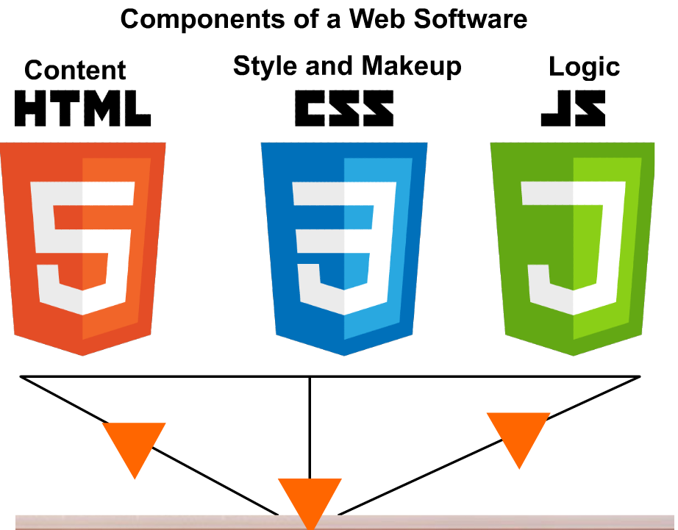

Slide 3
Introduction to HTML
HTML (Hyper Text Markup Language)
1). A markup language which was invented to structure of a web document.
2). HTML consists of a number of tags which wrap our content. Each tag essentially provides a different look.

Slide 4
Introduction to HTML
Example>
There is a cat
<b> There is a cat </b>
There is a cat

Slide 5
HTML TAGS ESSENTIALS
<h1> This is a heading </h1>
Tag starts from here
Tag ends here

Slide 6

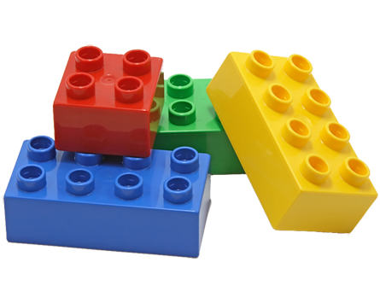
A web software consists of hundred or thousands of tags
img
div
h1
article
video

Slide 7


A web software consists of hundred or thousands of tags

Slide 8
HTML TAGS ESSENTIALS
Tags can be defined inside other tags.
<div> This code is inside a div tag. <h1> This is a heading </h1> </div>

Slide 9
Attributes
Attributes define specific characteristics of a tag
Fan tag has 2 attributes i.e. wings and size
<fan wings=“3” size=“56inch”></fan>
<fan wings=“4” size=“23inch”></fan>

Slide 10
Attributes
Attribute can alter the size, visibility, color and any other custom modifications.
Attributes provide additional information about tags.
Example>
id, name, style, class etc.

Slide 11
CORE HTML TAGS
Special Purpose section,
aside,
nav,
General Purpose

Slide 12
HOW TO USE HTML?
HTML helps us in structuring the layout of our web pages. Combining the given HTML tabs in different ways, we produce elegant websites.

Slide 13
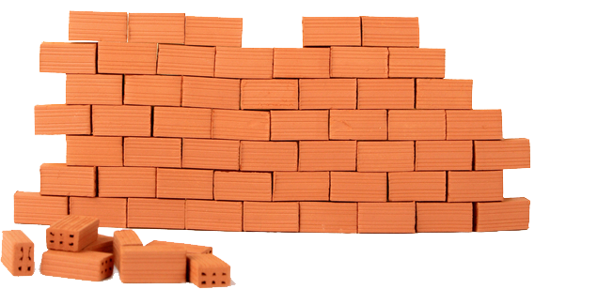
HTML makes up webpages!
HTML tags gather up together produce HTML sites.
DIV
DIV
SPAN
ASIDE

Slide 14
Node
A general concept given to all type of supported objects Type of nodes
Tags <h1>My HTML</h1>
Attributes
class=“city”
Comments <!– This is my comment →
Text some text in here

Slide 15
Check node type
<span id=‘mySpan’> This is my span</span>
mySpan.nodeType
//1
Comment
//8
Text
//3

Slide 16
A basic HTML document
<!DOCTYPE html> (It’s an HTML5 document)
<html lang="en">
<head> (HEAD Section all the additional information and expected behavior of our HTML document)
<meta charset="UTF-8">
<meta name="viewport" content="width=device-width, initial-scale=1.0">
<title>Document</title>
</head>
<body> (All the visible content will reside inside the body tag)
</body>
</html>

Slide 17
Attributes
Some tags posses attributes which are not applicable on other tags. Example <img src=“cat.jpg” />
<div src=“cat.jpg”></div>
<video src=“my-video.mp4”></video>

Slide 18
MOST COMMONLY USED HTML TAGS
UL / OL
DIV, SECTION, SPAN TABLE,

Slide 19
UL
Used to structure a HTML list which encompasses multiple items.
Example>
<ul> (Unordered list starts) <li>Pakistan</li> (list item) <li>India</li> <li>Iran</li> </ul> (Unordered list ends) Note> UL only contains li tags
<ol> (Ordered(Numbered) list starts) <li>Pakistan</li> (list item) <li>India</li> <li>Iran</li> </ol> (Ordered(Numbered) list ends)

Slide 20
MOST COMMONLY USED HTML TAGS
DIV The most general purpose HTML division element
Table An HTML element for structuring tabular data.

Slide 21
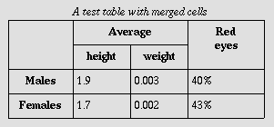
Table
TD
TD
TD
TD
TR
TR
TR
TR

Slide 22
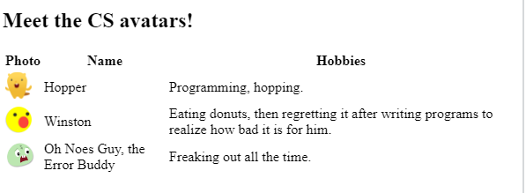
Today’s Assignment

